Slide 1

Tourism and GDP Analysis
Team Members: -
Sushma Chirra- 11558420
Achyutanand Mishra- 11542607
Ram Rallabandi – 11547220

Slide 2
Workflow
Data collection
Data Preprocessing
Data visualization
Data cleaning
Data transformation
Data integration

Slide 3
DATA VISUALIZATION
Data visualization
Tableau
Vizhub(d3.js)
Bar chart
Select tool
python
Line chart
Select idiom
Scatter plot

Slide 4
Architecture
Data source
Data understanding
Data preprocessing
Visualization

Slide 5
Methodology
Understand the Business
Collect data
Data preparation
Validation
no
ok
Visualization

Slide 6
Features:
Inbound tourist arrival of country
Revenue generated by tourism
Features
Relationship b/w tourism & GDP
Popular tourist Destination
Top revenue generated by each country

Slide 7
Tools
Tableau
Tools
Viz Hub
Python

Slide 8

Implementations

Slide 9
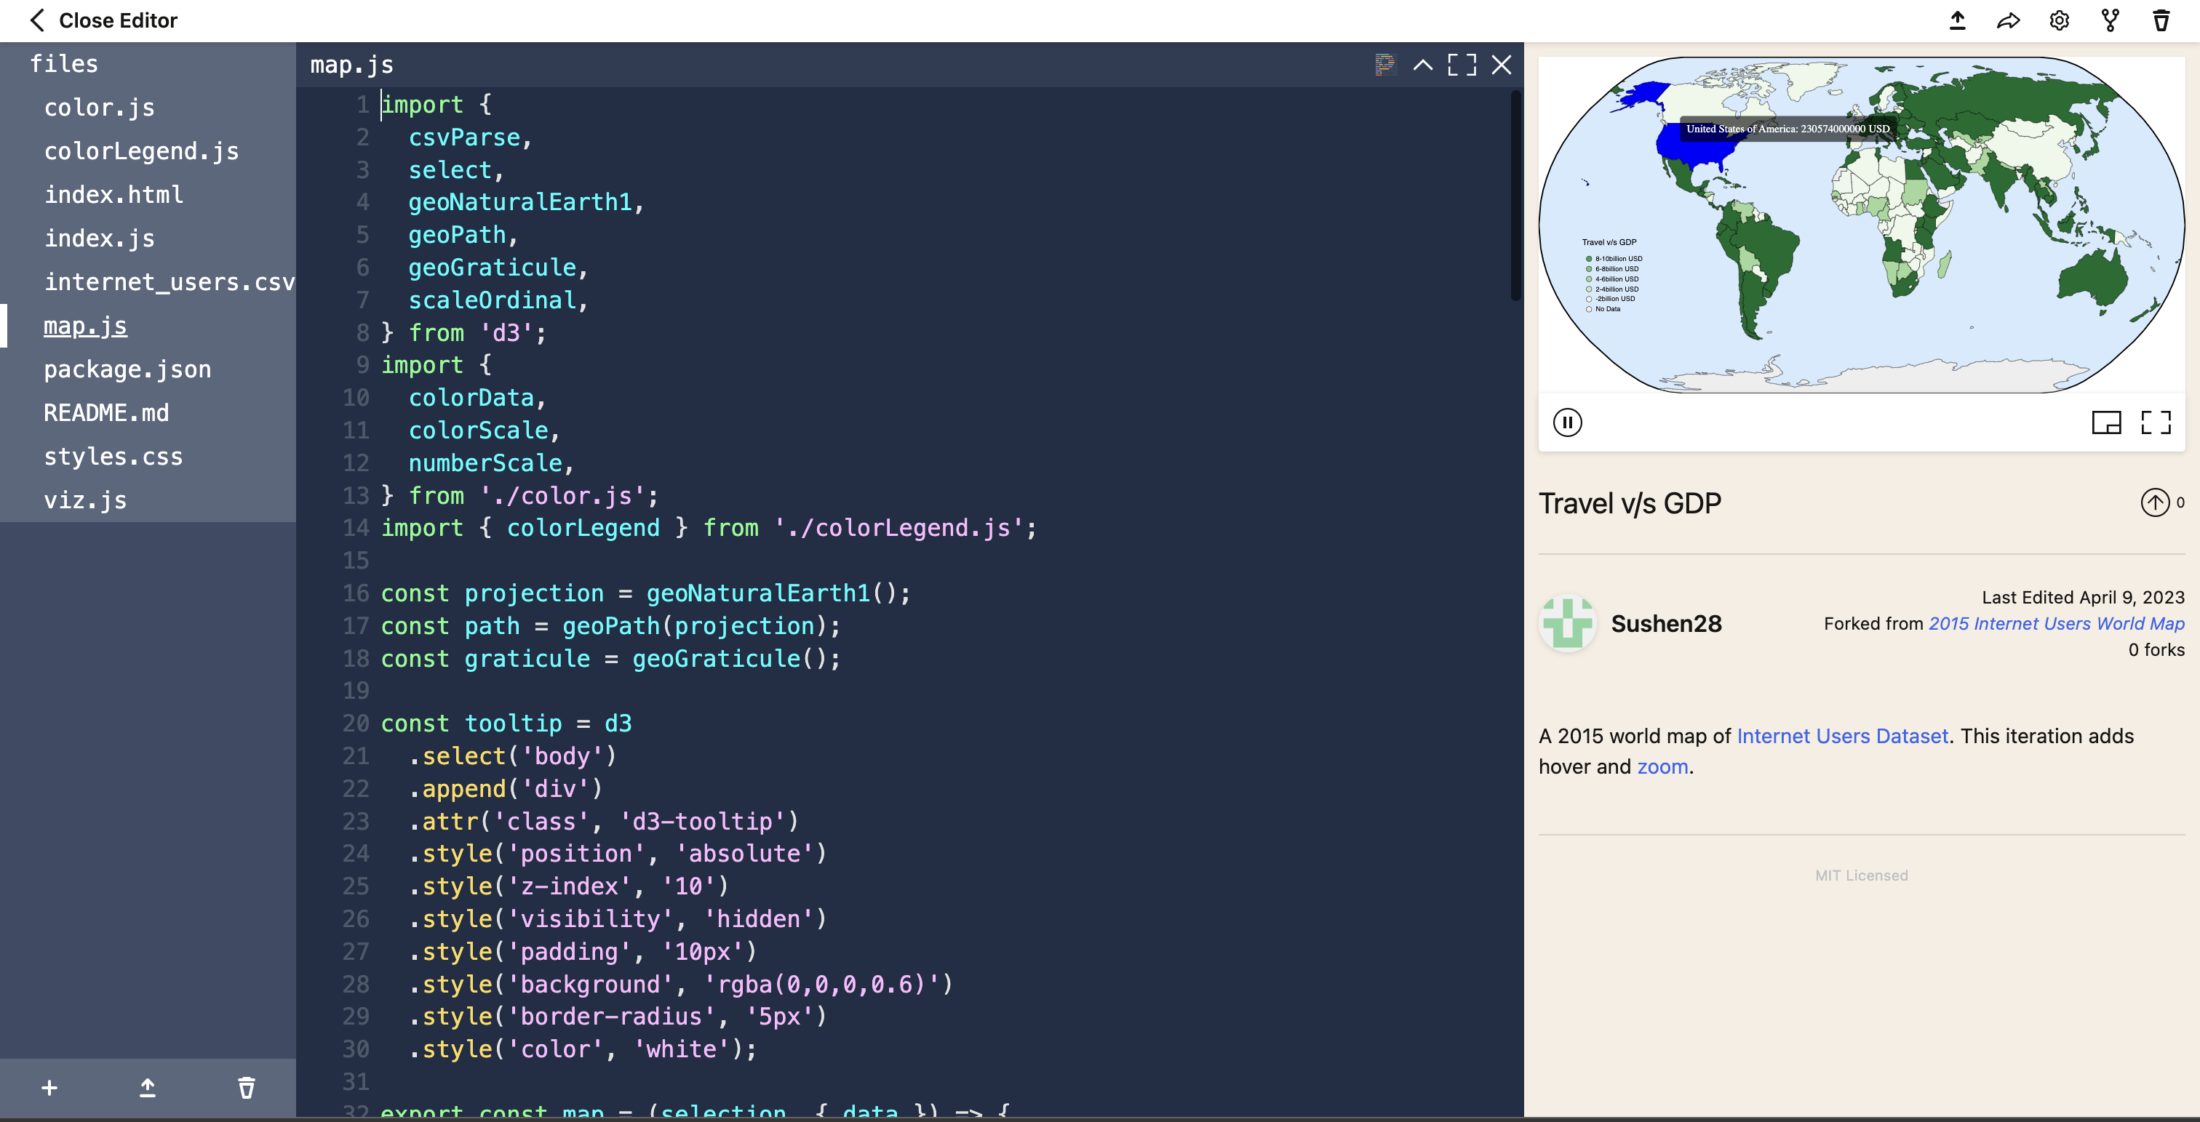
Viz hub- World Map

Slide 10
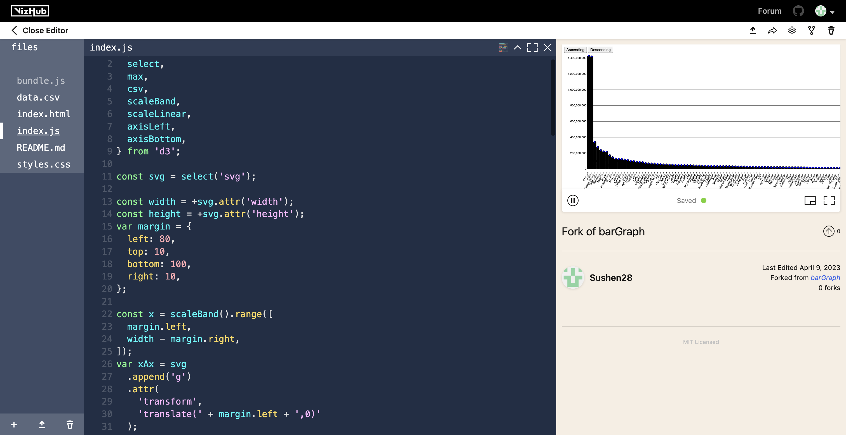
Viz Hub- Bar Chart

Slide 11
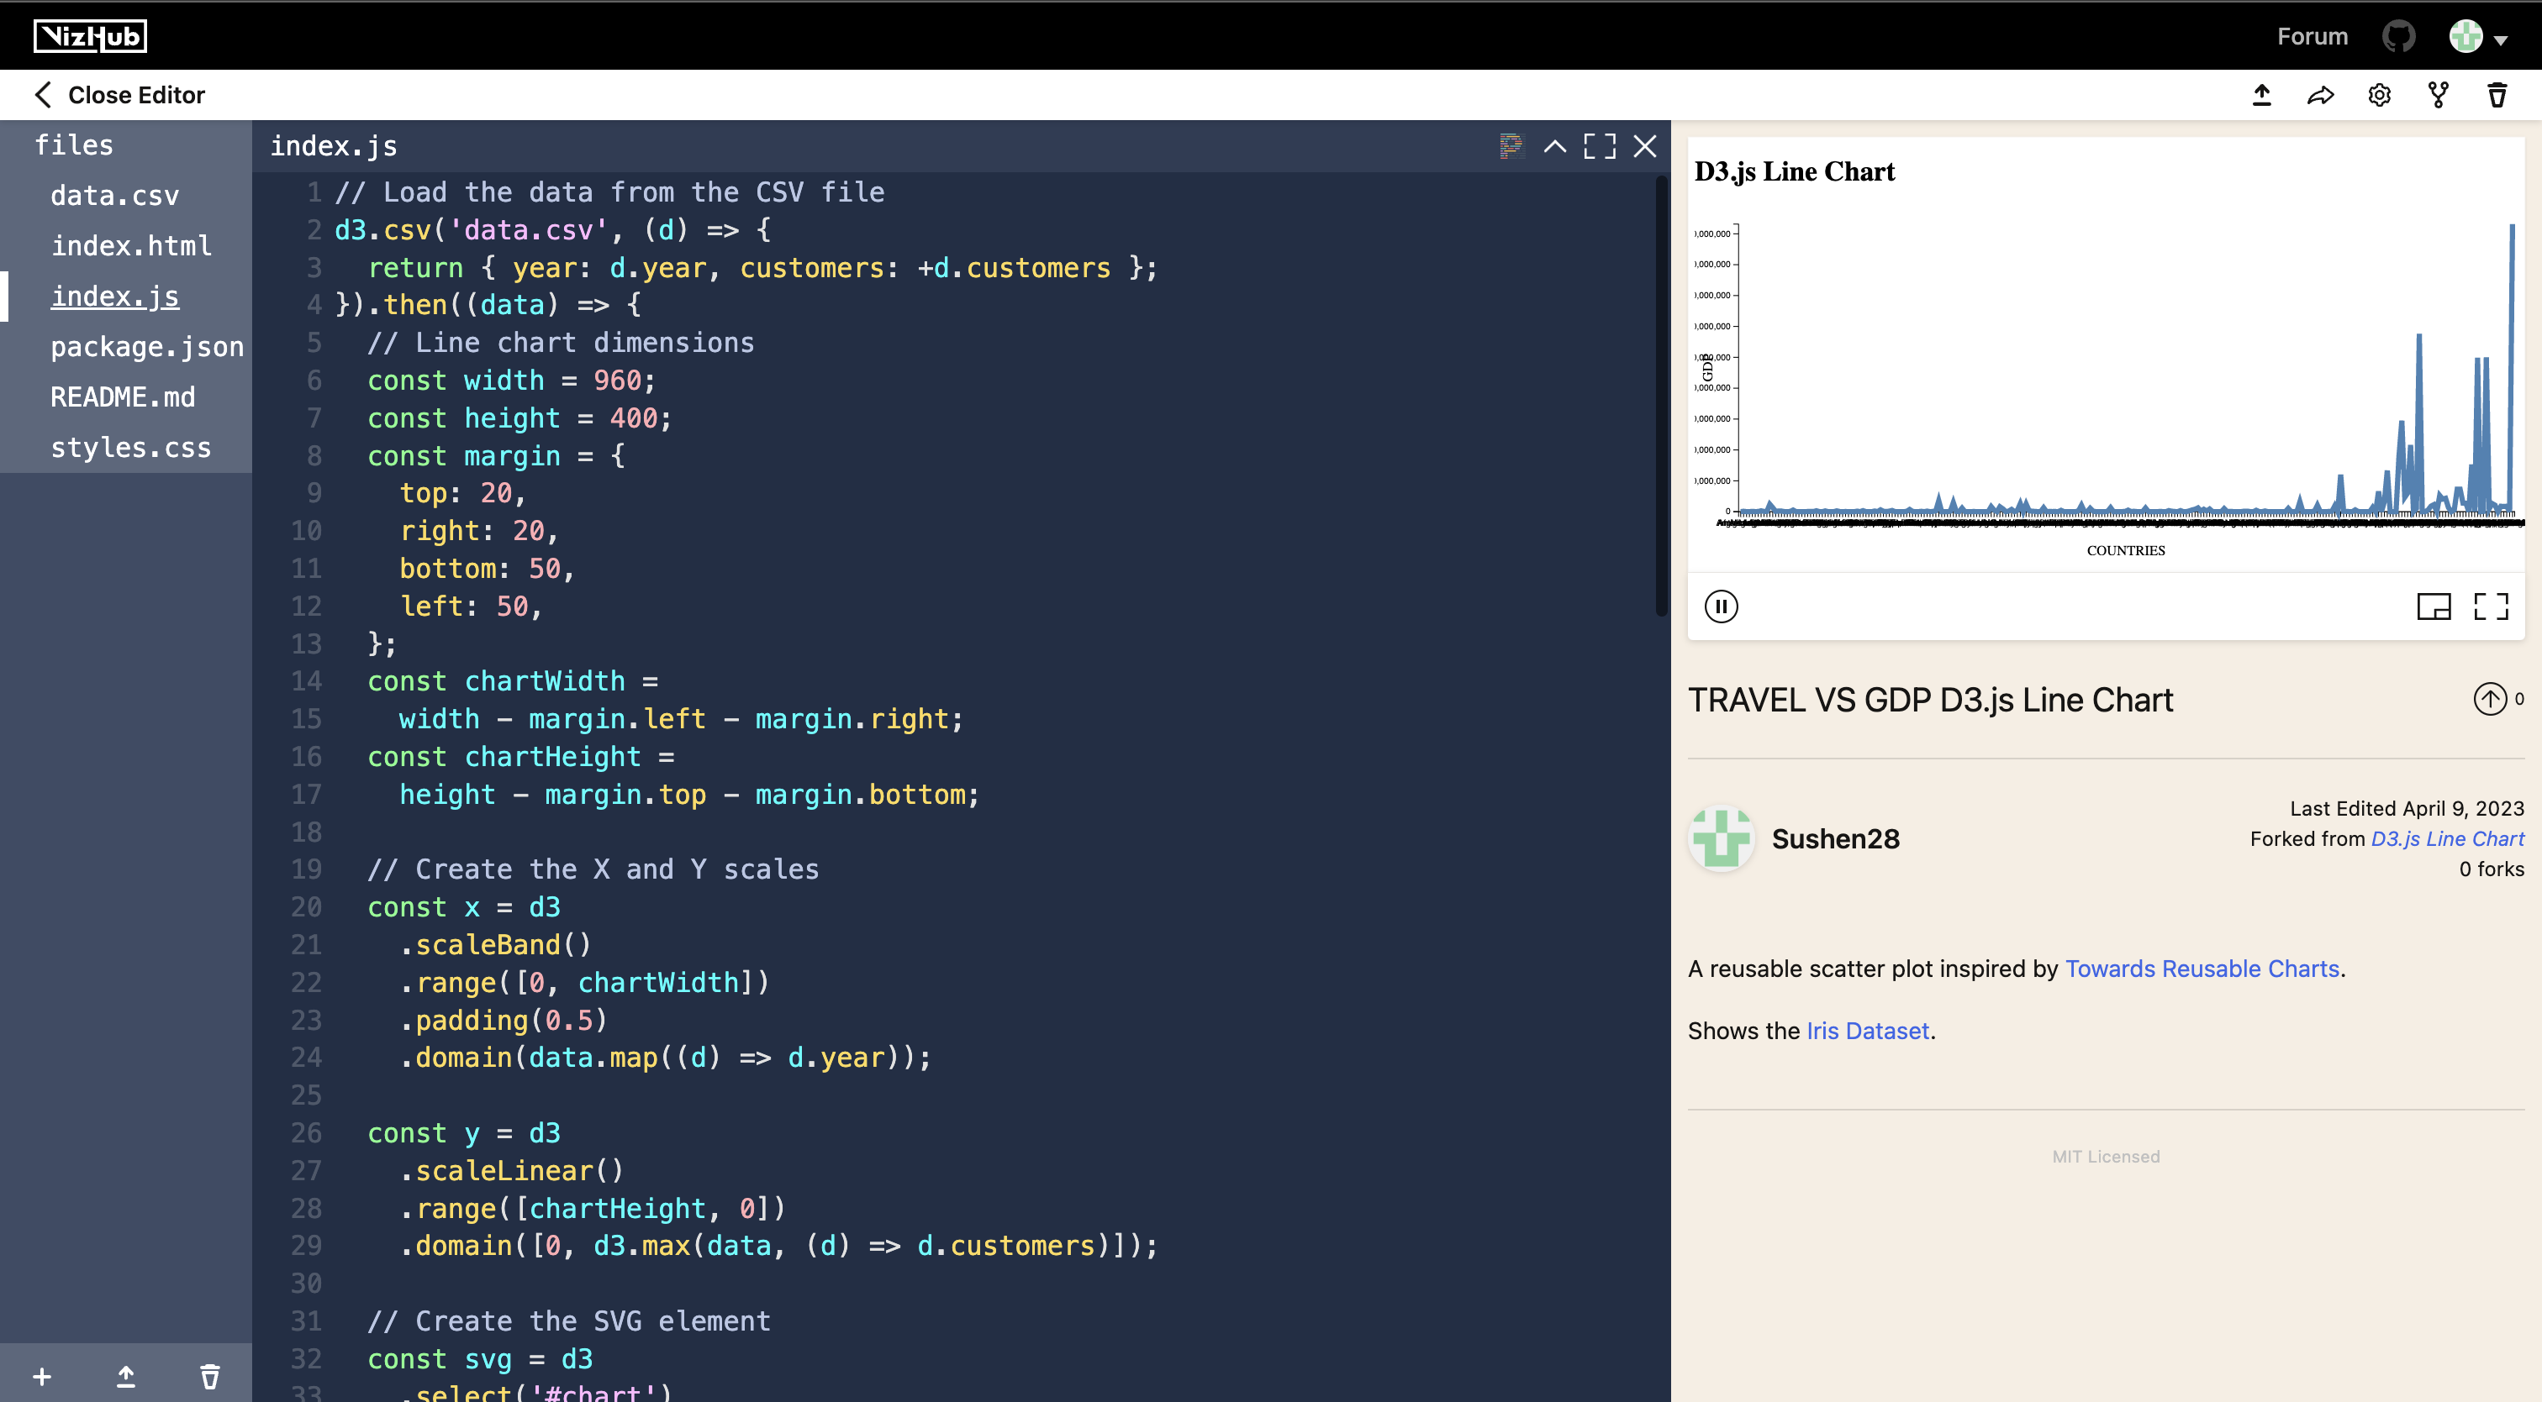
Viz Hub- Line Graph

Slide 12
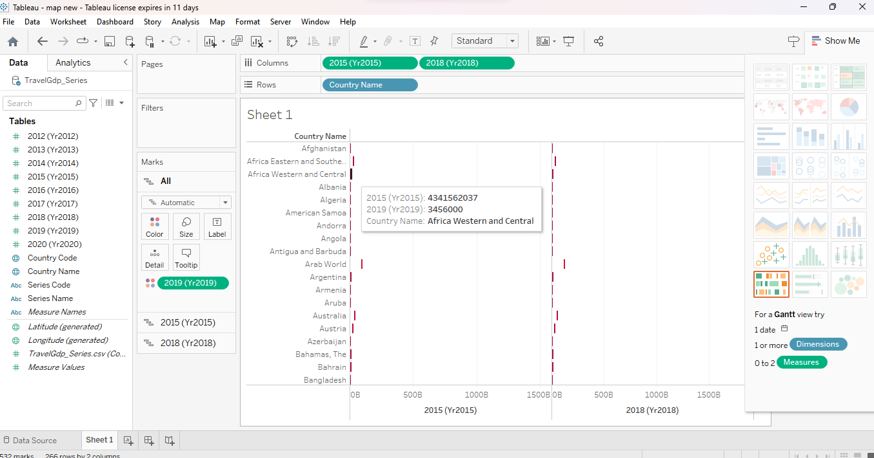
Tableau-Stacked Bar

Slide 13
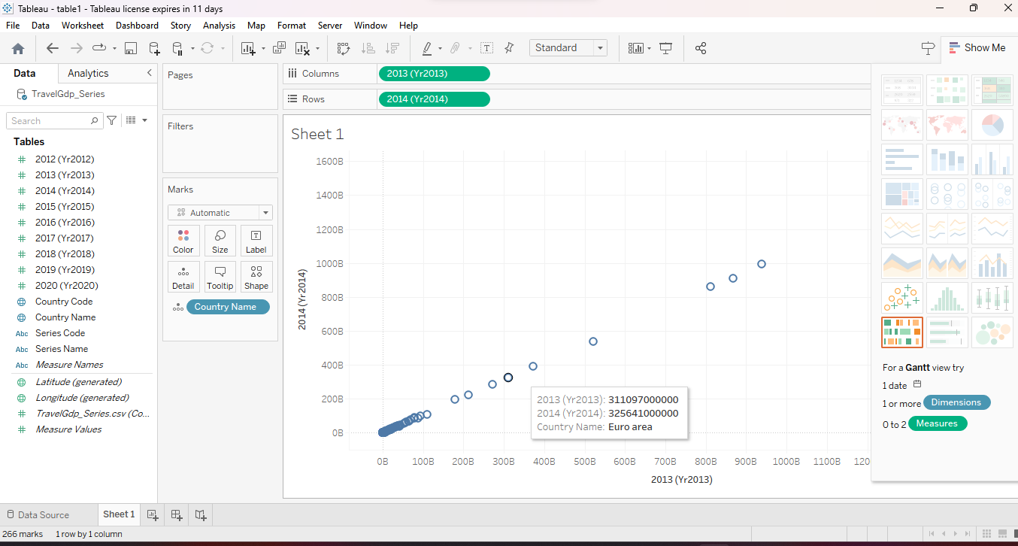
Tableau – Scatter Plot

Slide 14
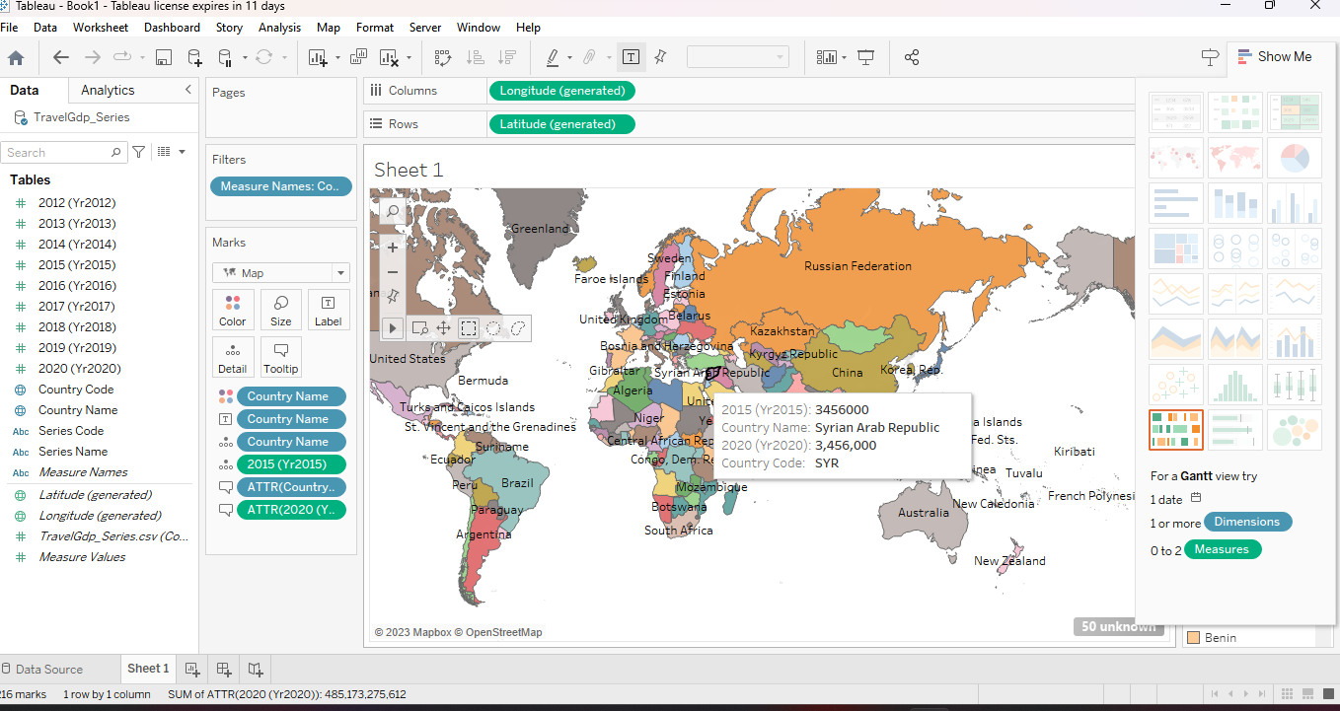
Tableau- Map Idiom

Slide 15
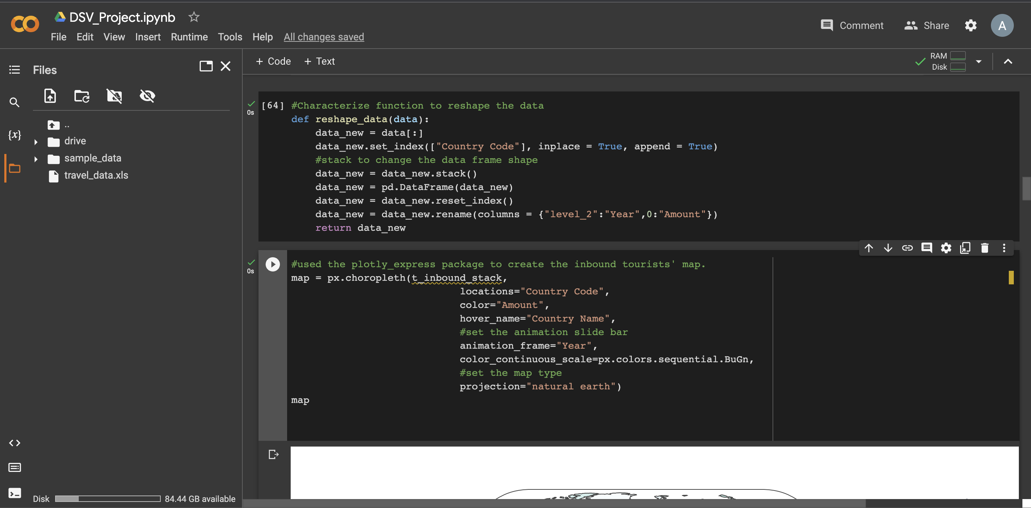
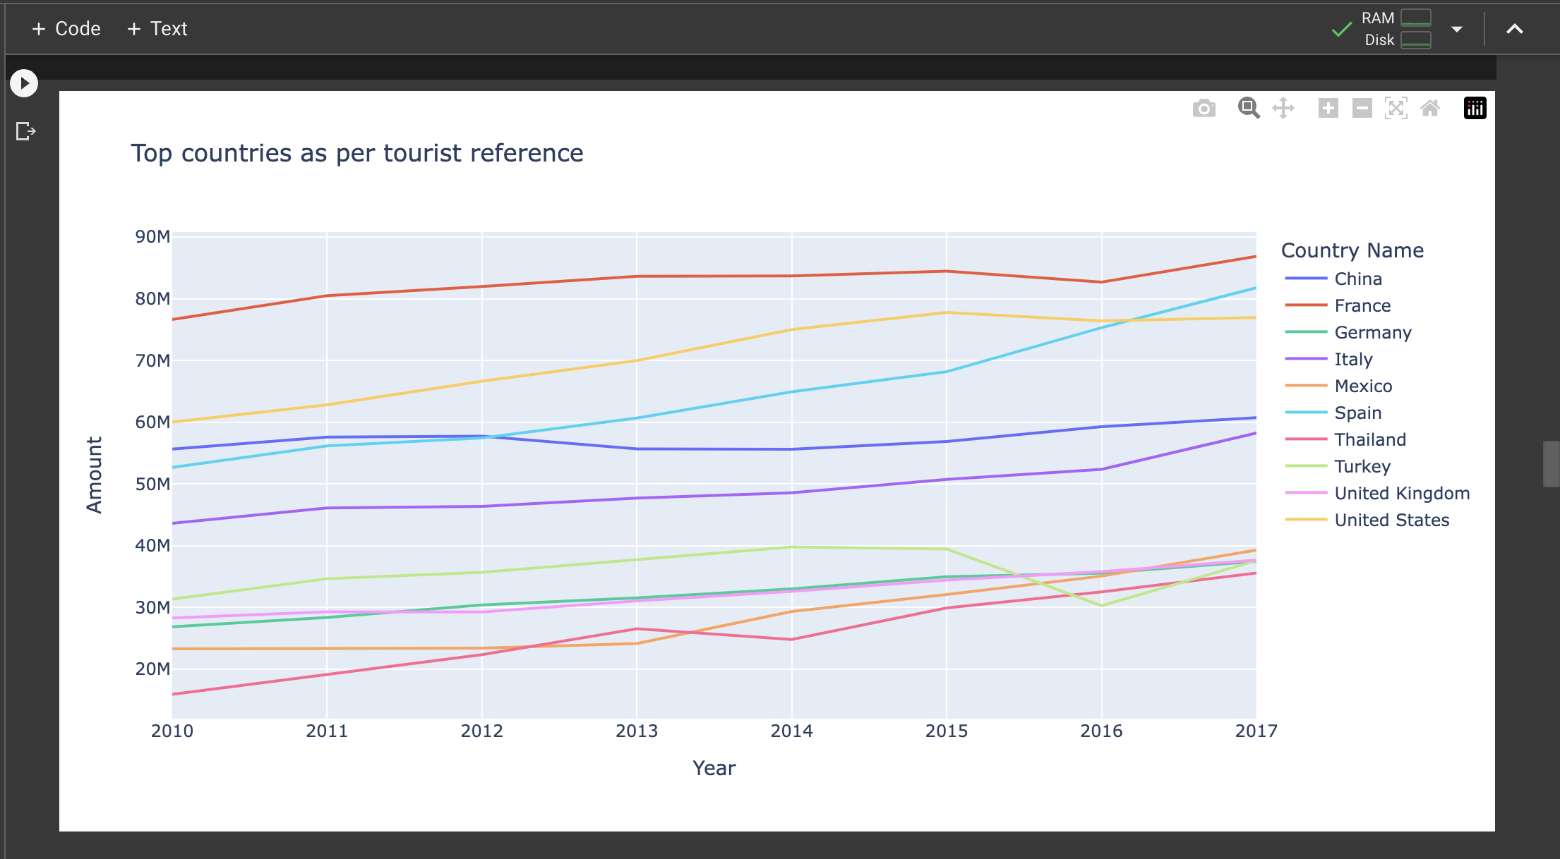
Python – Line Graph

Slide 16
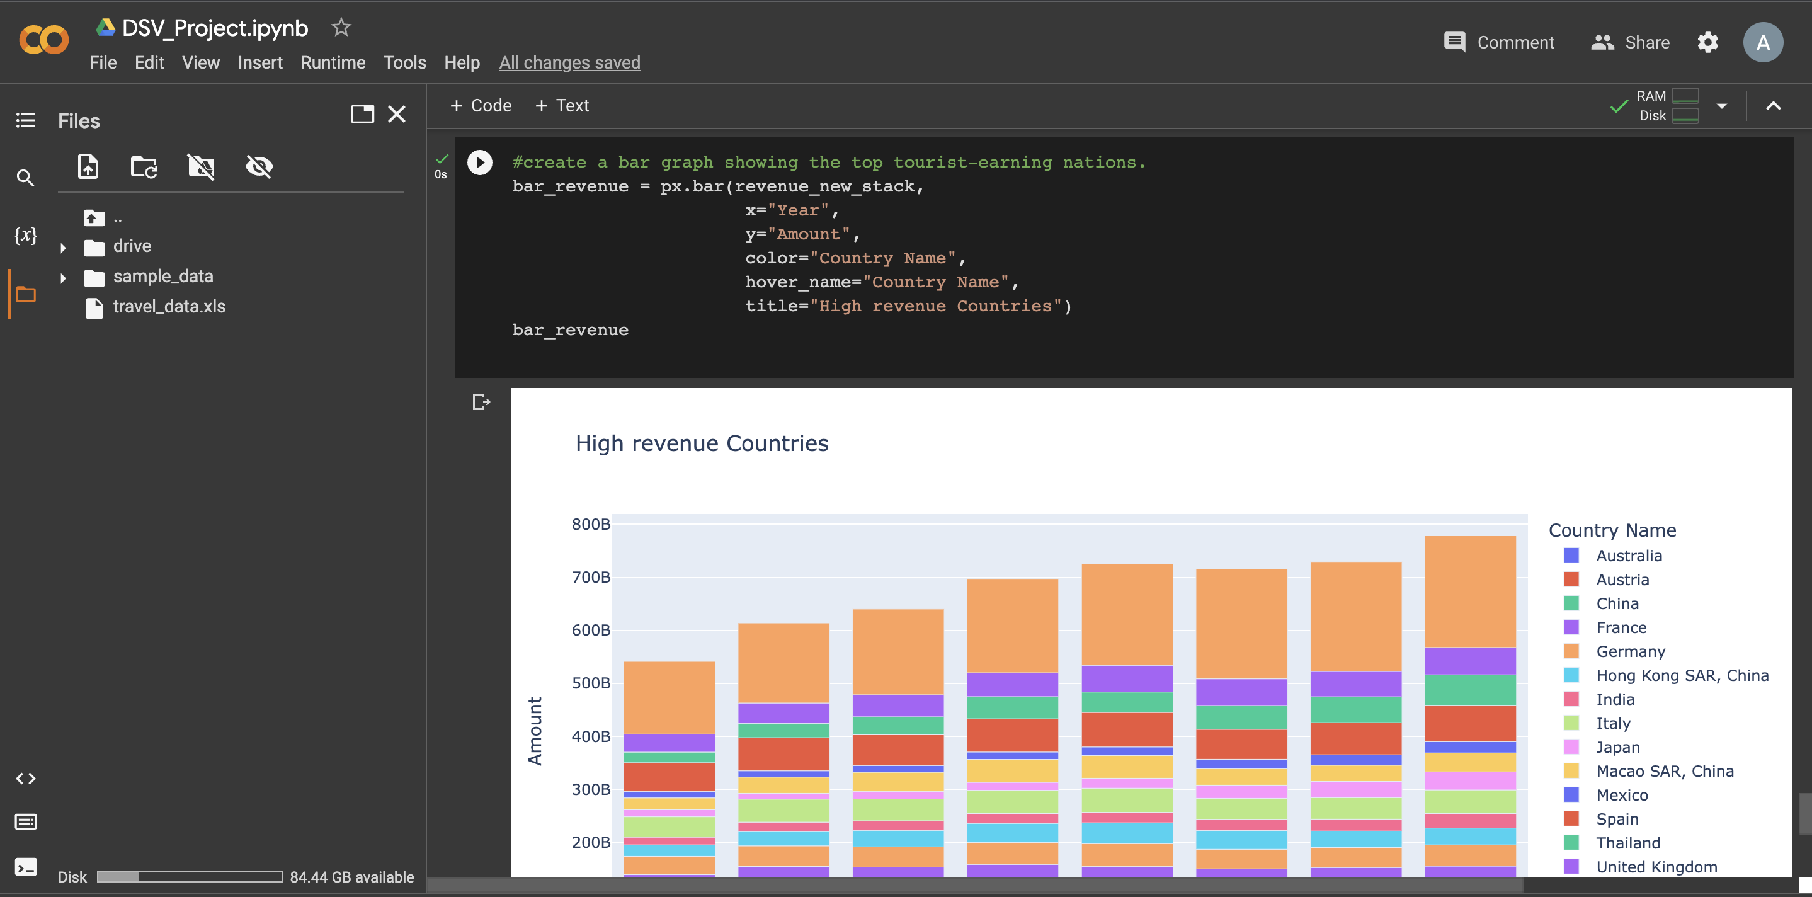
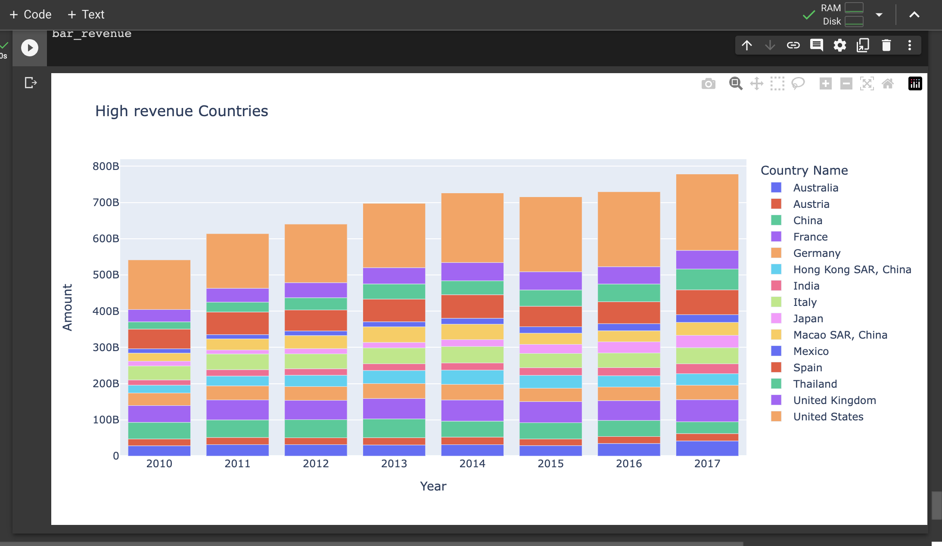
Python -

Slide 17

Visualization Of Result: -

Slide 18
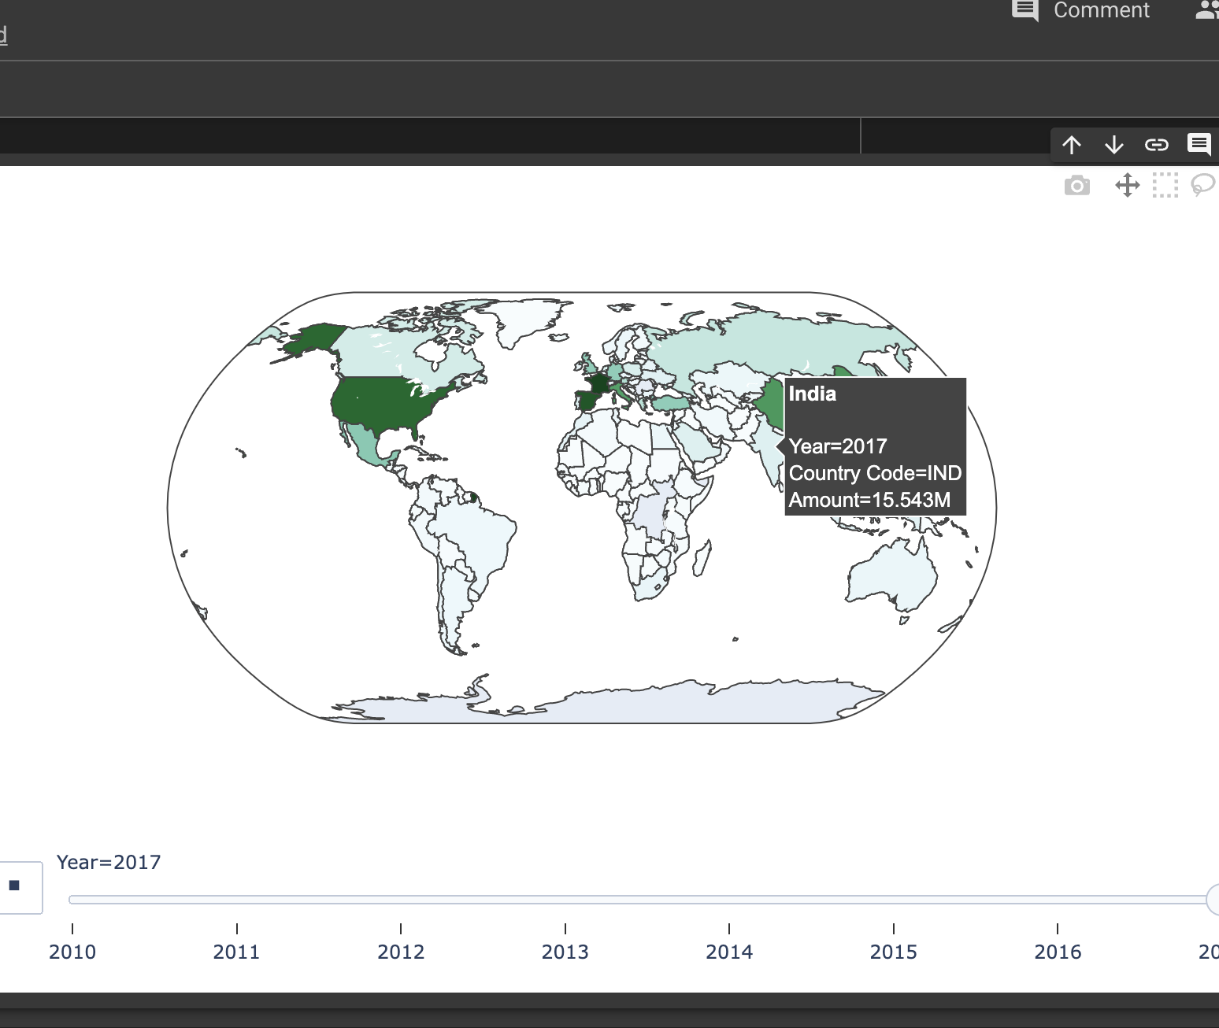
Python: Map Visualization

Slide 19
Python: Line Graph

Slide 20
Python:

Slide 21
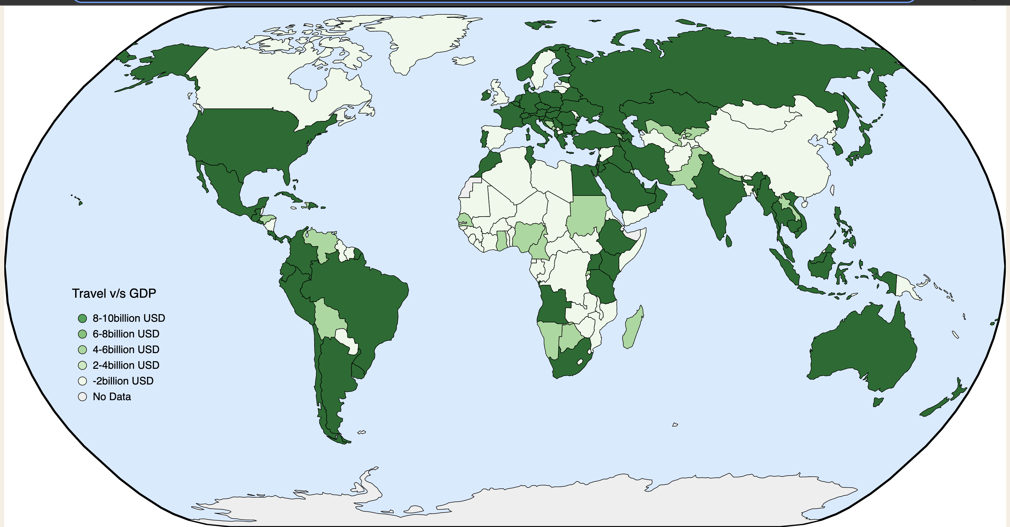
Viz Hub: - Map Visualization

Slide 22
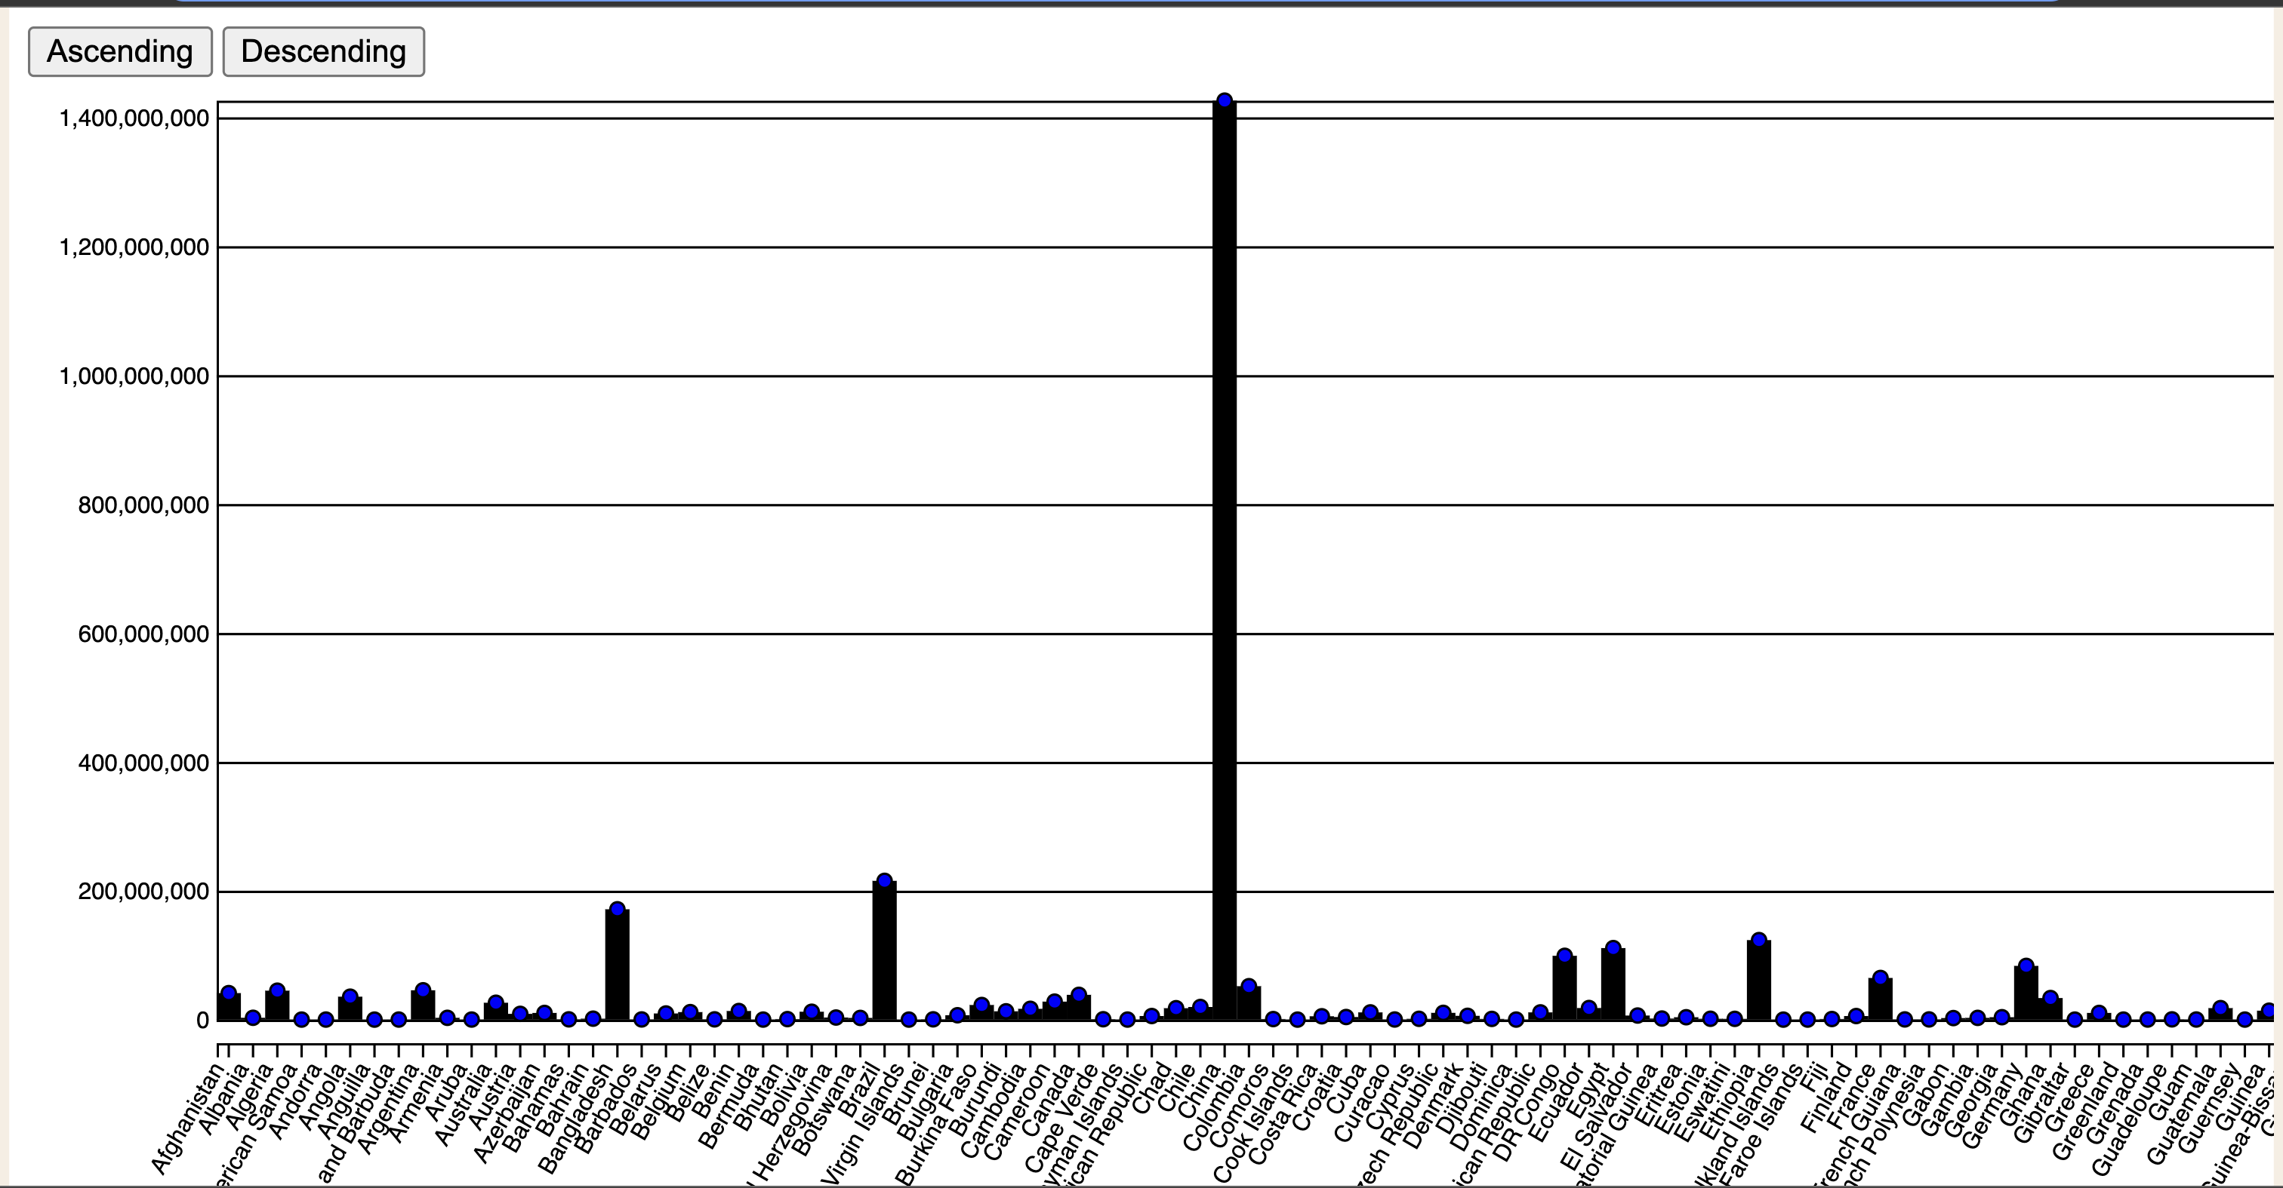
Vizhub: Bar Graph

Slide 23
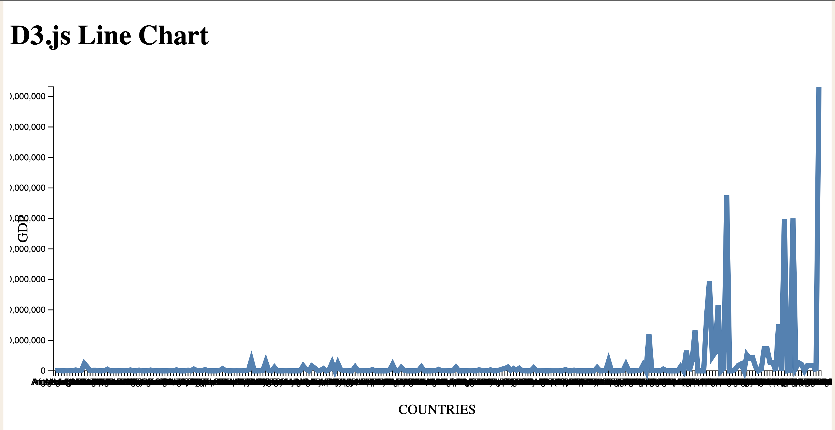
Viz Hub: Line Graph

Slide 24
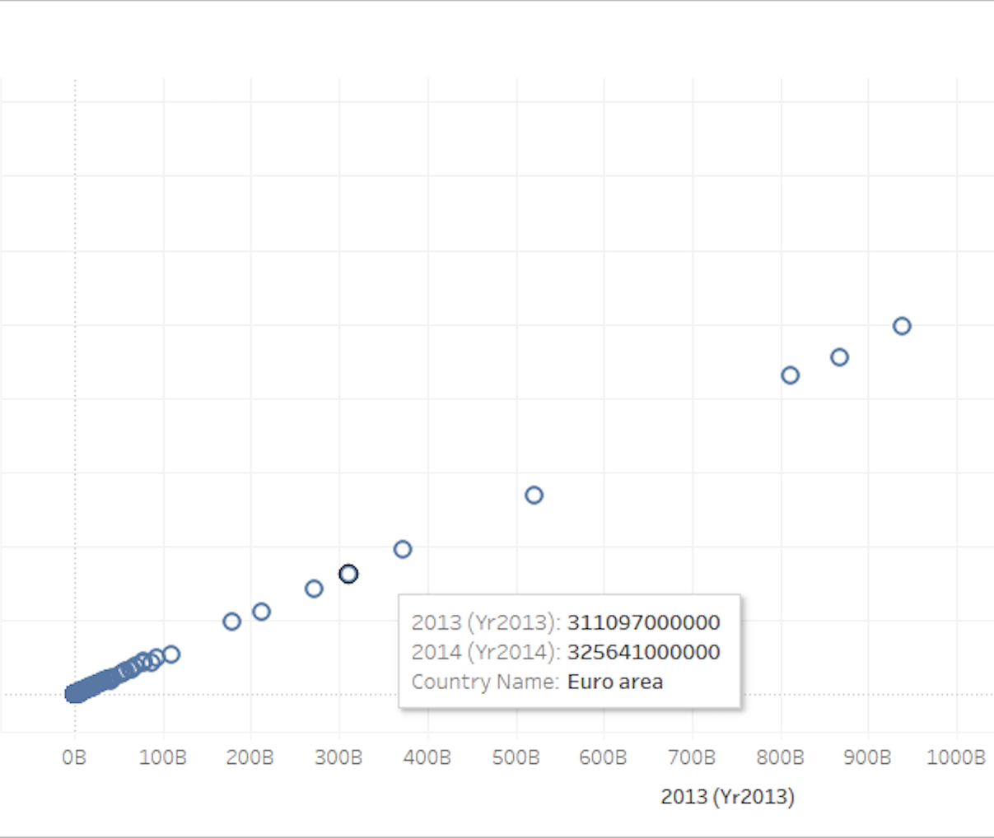
Tableau: Scatter Plot

Slide 25
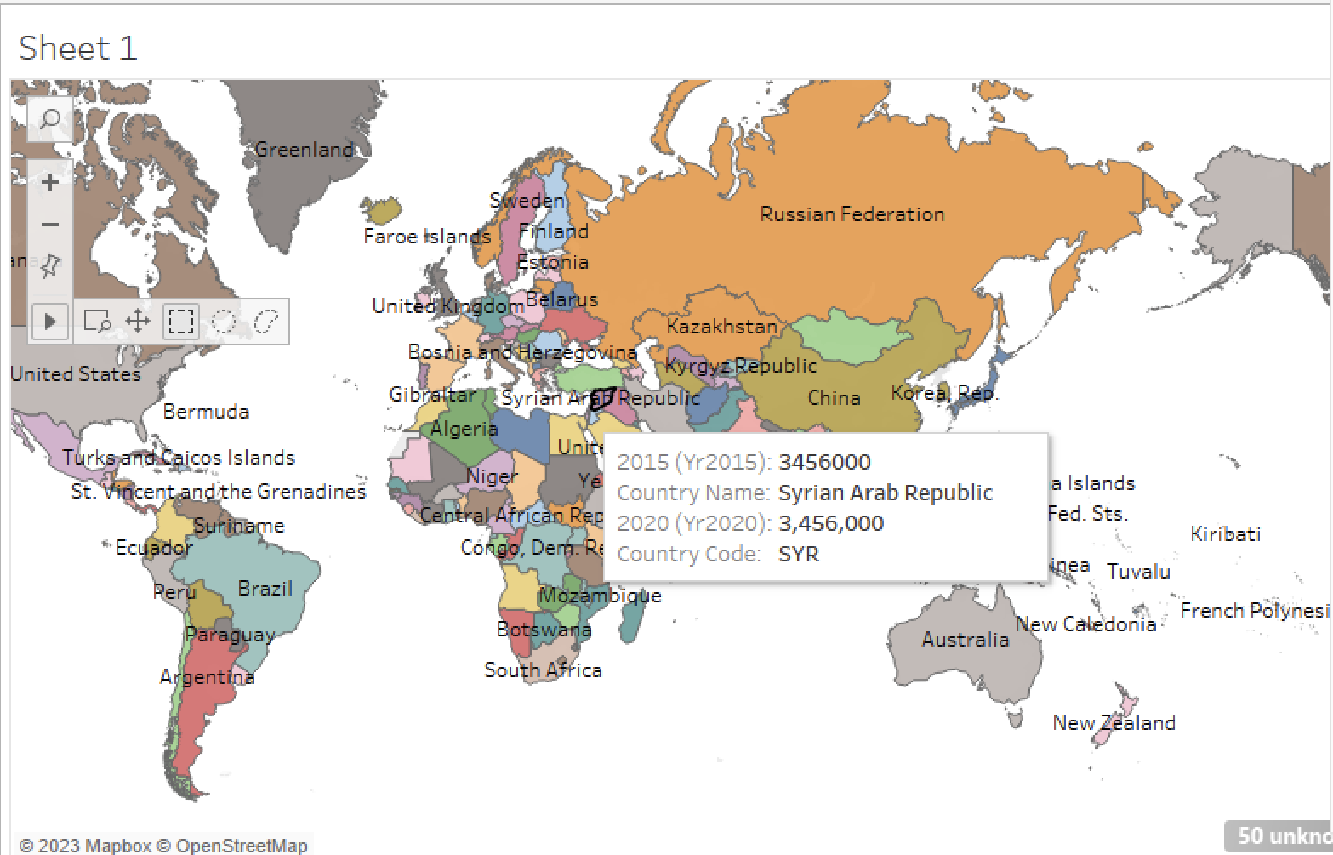
Tableau: Map Visualization

Slide 26
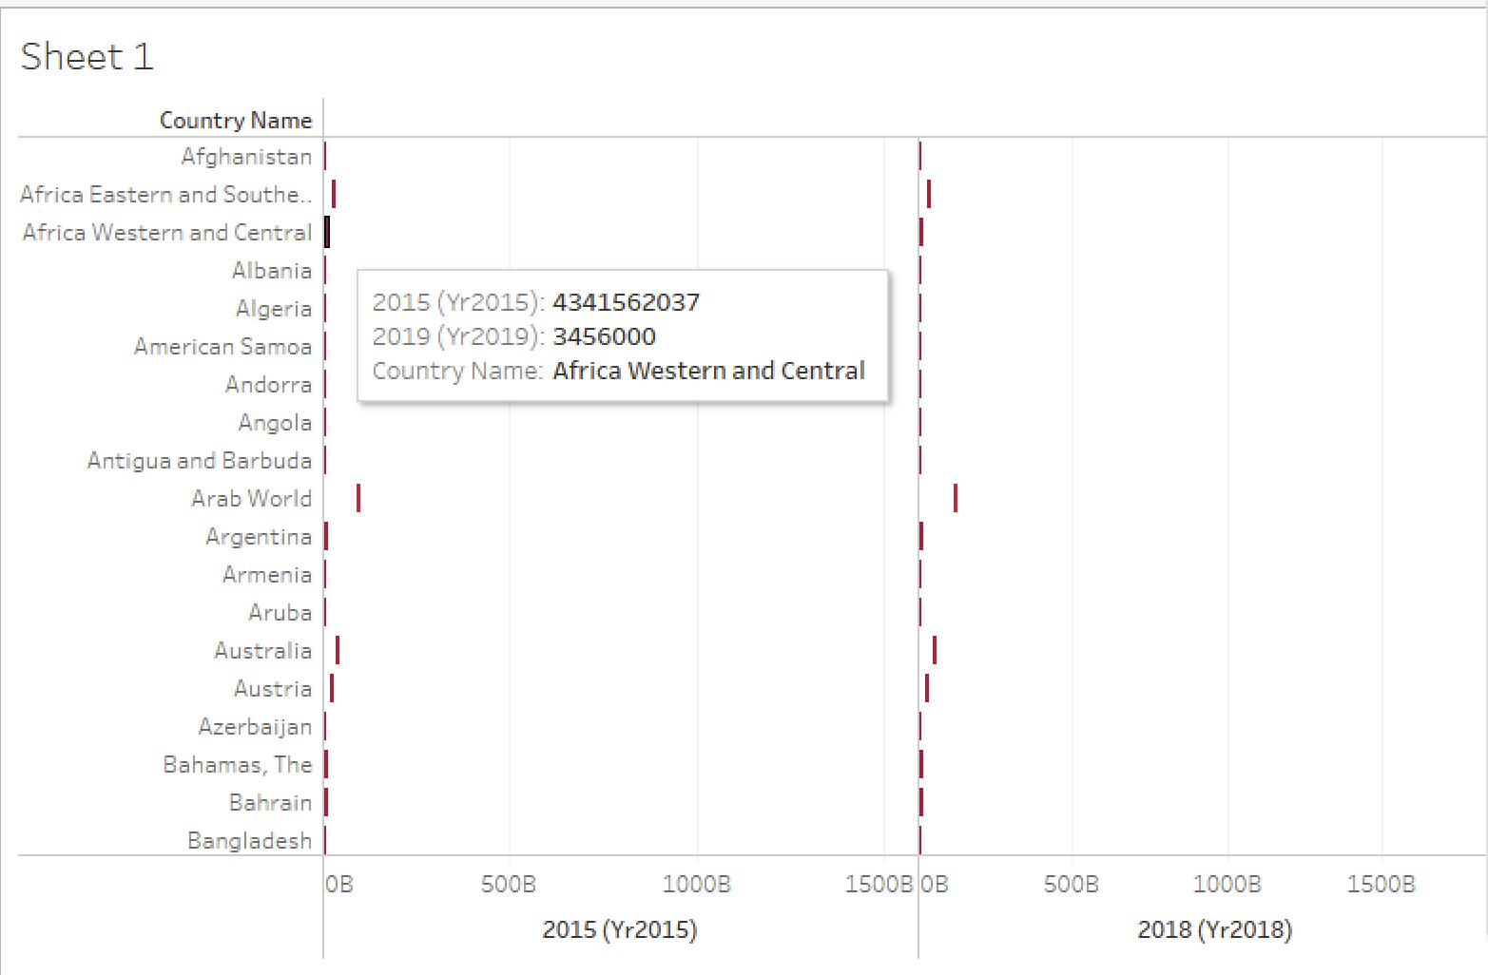
Tableau: Stacked Visualization

